Slide 1
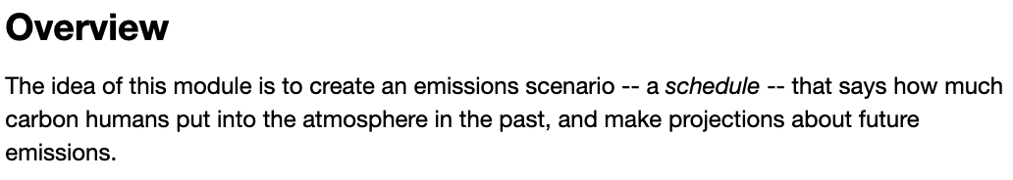
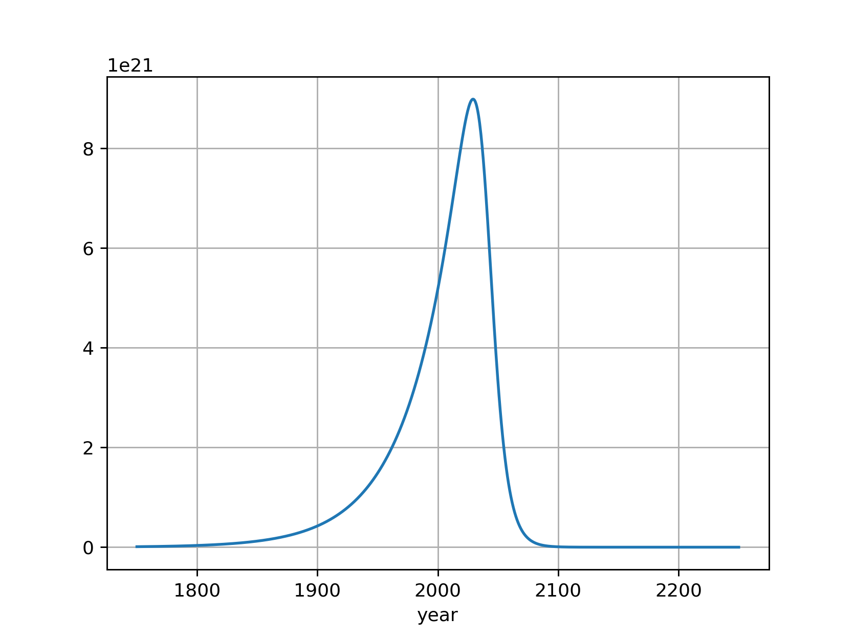

Introduction to scheduled flows

Slide 2
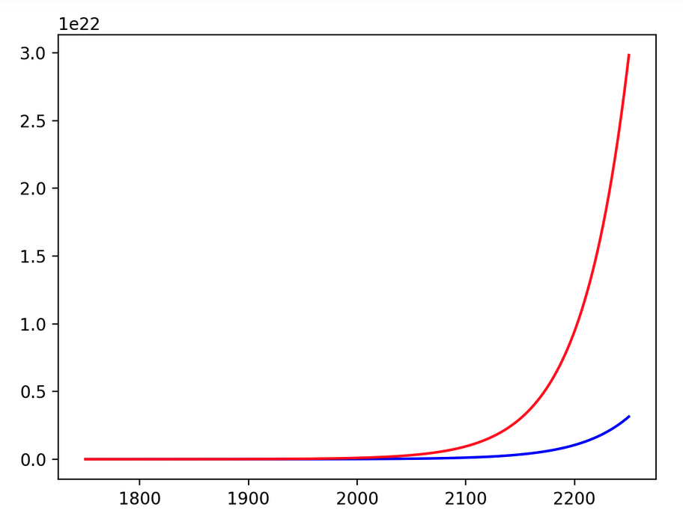
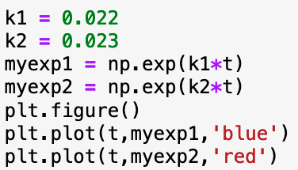


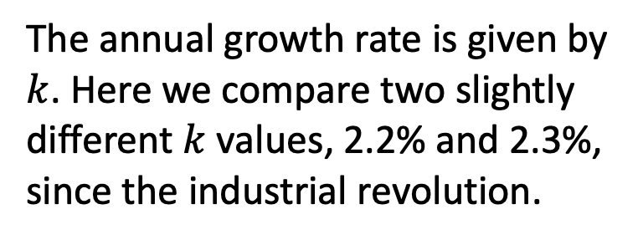
Early growth is assumed to be exponential
The annual growth rate is given by $k$. Here we compare two slightly different $k$ values, 2.2% and 2.3%, since the industrial revolution.
$$exp⁡(kt)$$
$$t$$

Slide 3
Exponential growth is characterized by a doubling time
Start at some time
$$exp⁡(kt)$$
$$t$$

Slide 4
Exponential growth is characterized by a doubling time
Doubles after 30 years
$$exp⁡(kt)$$
$$t$$

Slide 5
Exponential growth is characterized by a doubling time
Doubles again after another 30 years!
$$exp⁡(kt)$$
$$t$$

Slide 6
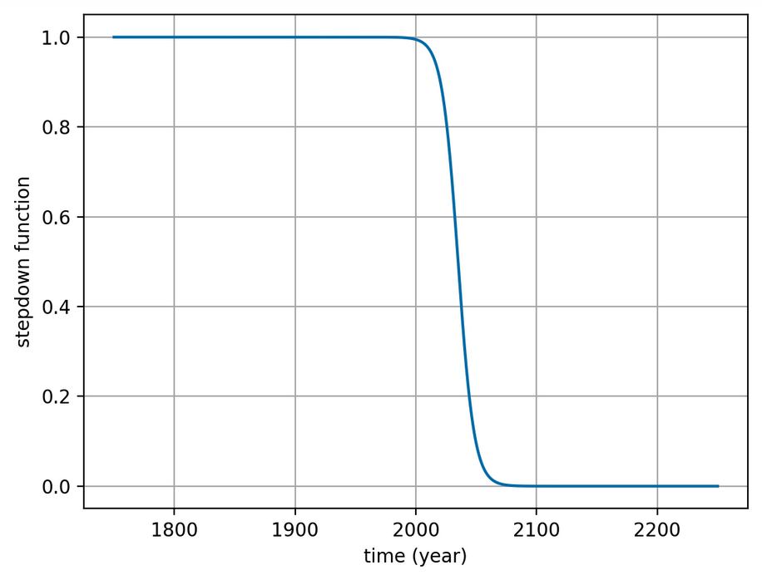
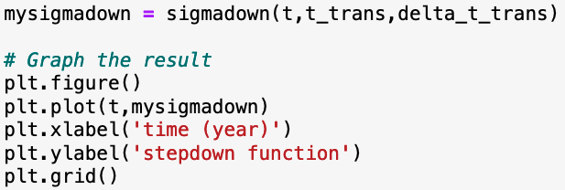

Decarbonization is assumed to follow a step-down sigmoid function
$$σ_{down}$$

Slide 7
Decarbonization is assumed to follow a step-down sigmoid function
$$σ_{down}$$
t is an array of times
t_trans is the transition year (2040)
delta_t_trans is the transition time (20 years*)
Meaning, it takes 20 years to go from .8 to .2 (the “80/20 rule”)

Slide 8
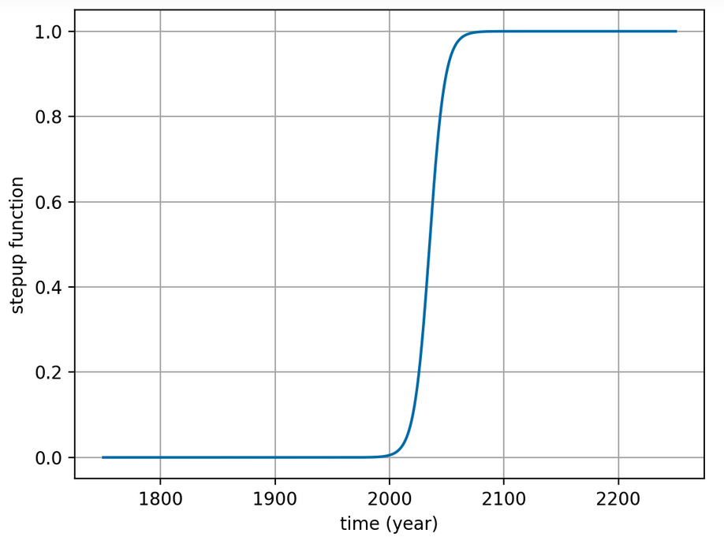
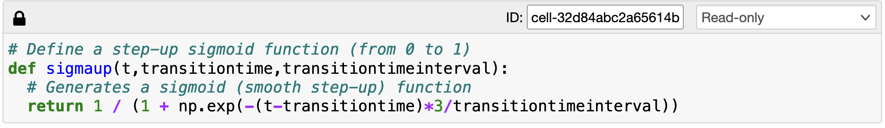

“Scaffolded learning” => you get the $σ_{up}$ function
$$σ_{up}$$

Slide 9
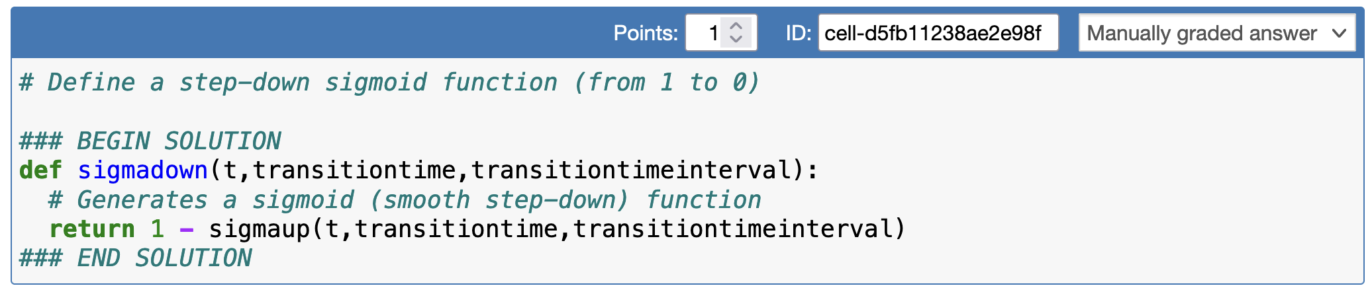

You have to write $σ_{down}$
$$σ_{up}$$
$$σ_{down}$$

Slide 10
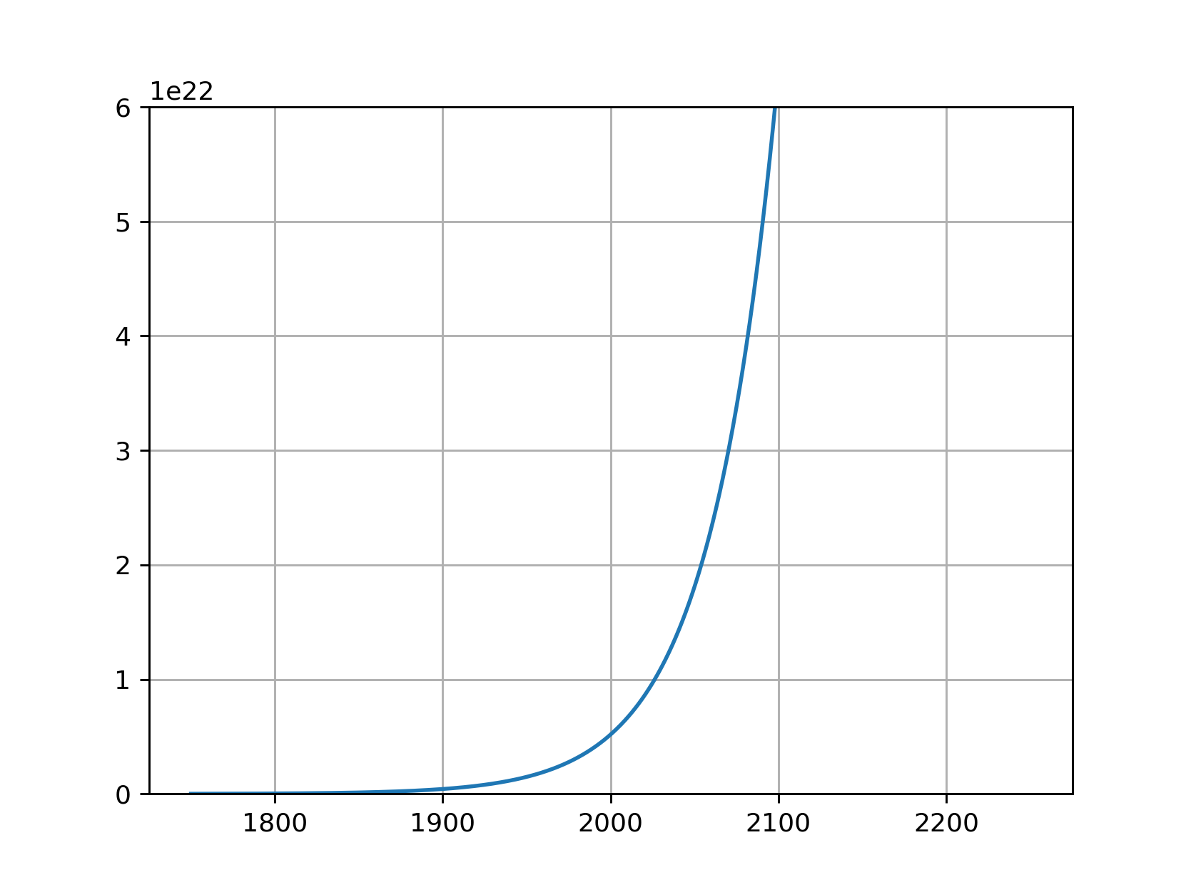
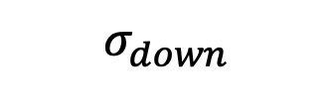


Product of exponential and sigmoid
$$exp⁡(kt)$$
So far, so good:
The shape seems right.
We can shift to later or earlier times by adjusting t_trans.
We can stretch out/compress the transition time by adjusting delta_t_trans.
$$σ_{down}$$
$${\exp\left(kt\right)× σ}_{down}$$

Slide 11
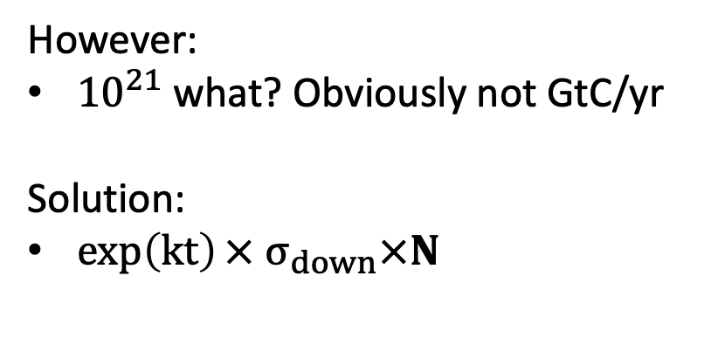
Product of exponential and sigmoid
$$exp⁡(kt)$$
However:
${10}^{21}$ what? Obviously not GtC/yr
Solution:
${\exp\left(kt\right)× σ}_{down}×N$
$$σ_{down}$$
$${\exp\left(kt\right)× σ}_{down}$$

Slide 12

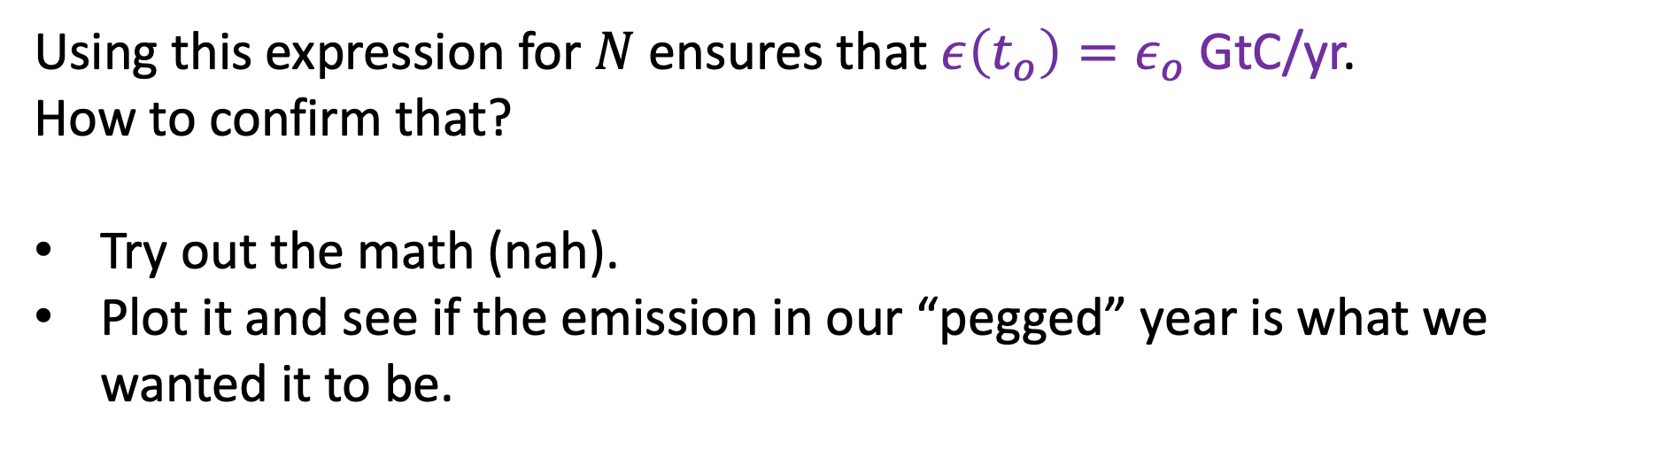
Normalizing
Using this expression for $N$ensures that $ε\left(t_{o}\right)=ε_{o}$ GtC/yr.
How to confirm that?
Try out the math (nah).
Plot it and see if the emission in our “pegged” year is what we wanted it to be.

Slide 13
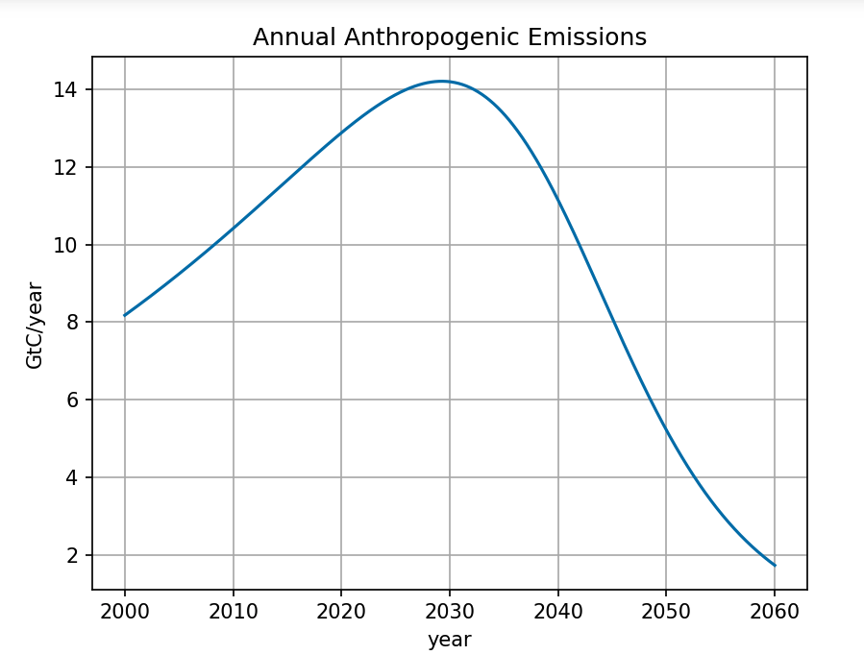
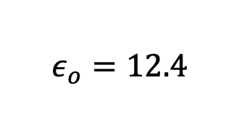



Verifying that this normalization works
$$ε_{o}=12.4$$
$$t_{o}=2018$$
$$t_{0}=2018$$

Slide 14
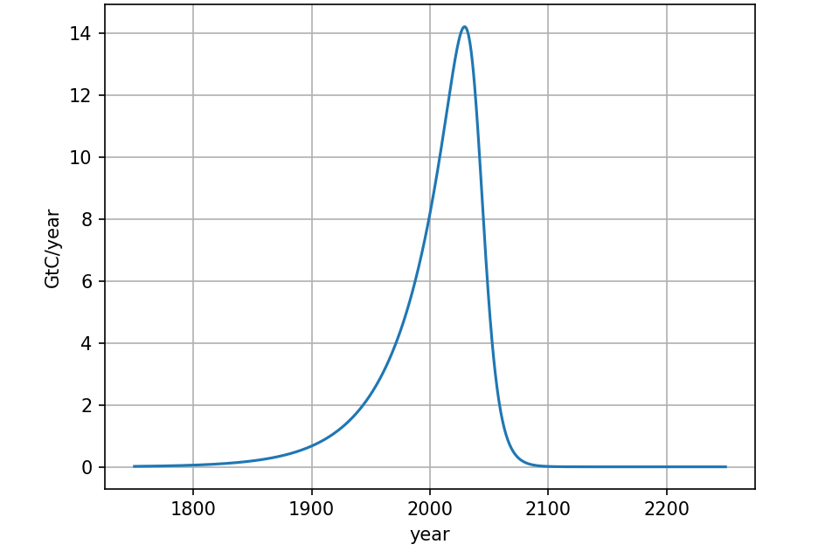
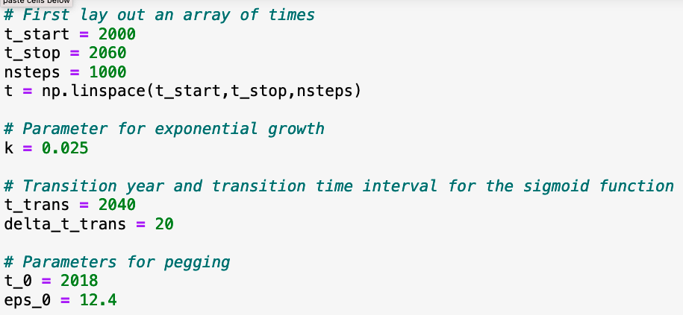
I’ll want you to expand the timescale too
…

Slide 15
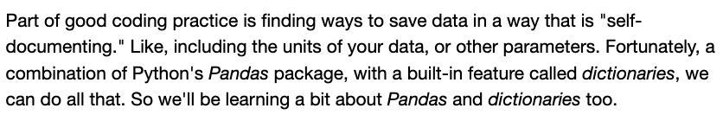
Metadata

Slide 16
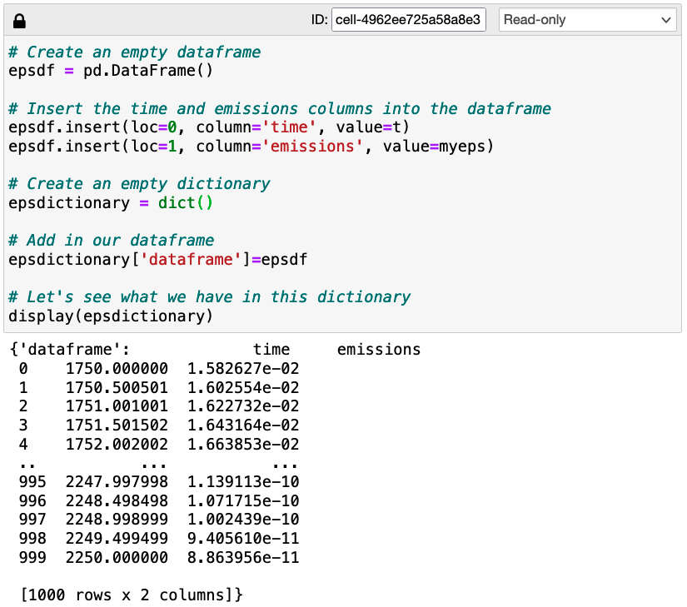
Metadata

Slide 17
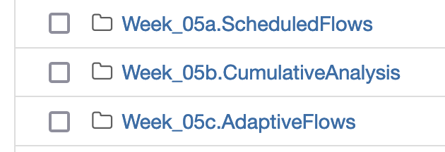
Python work this week
Today
Between today and Friday (it’s short)
Friday – I’ll walk through it with a few more Powerpoint slides
Link

